Slide 1


Master Security – Session 5: Red Teaming ML-Based Systems
Prof. Dr.-Ing. Sebastian Schlesinger
Professor of Business Computer Science (Safe and Secure Systems Engineering & Verification)

Slide 2
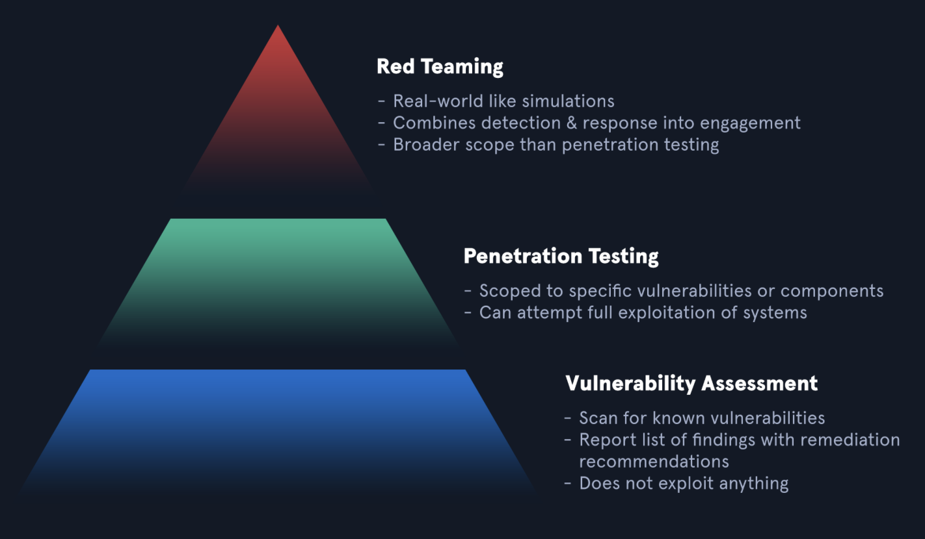
What is Red Teaming?

Slide 3
Types of exercises to identify vulns
Vuln Assessments
Focus on identifying, cataloging, prioritizing known vulns
Do not involve exploitation
Comprehensive scan of systems, applications, networks
Tools e.g. Nessus, OpenVAS
Identify and exploit vulns
Time-bound
Structured process
Often in isolated network segments or web application instances

Slide 4
Types of exercises to identify vulns
Red Teaming
Adversarial simulation
Mimic real-world attackers‘s tactics, techniques, and procedures to test defenses
Evade detection by blue team
What is special with ML-based systems?
ML-based systems face unique vulns because they rely on large data sets, statistical inference, complex model architectures

Slide 5
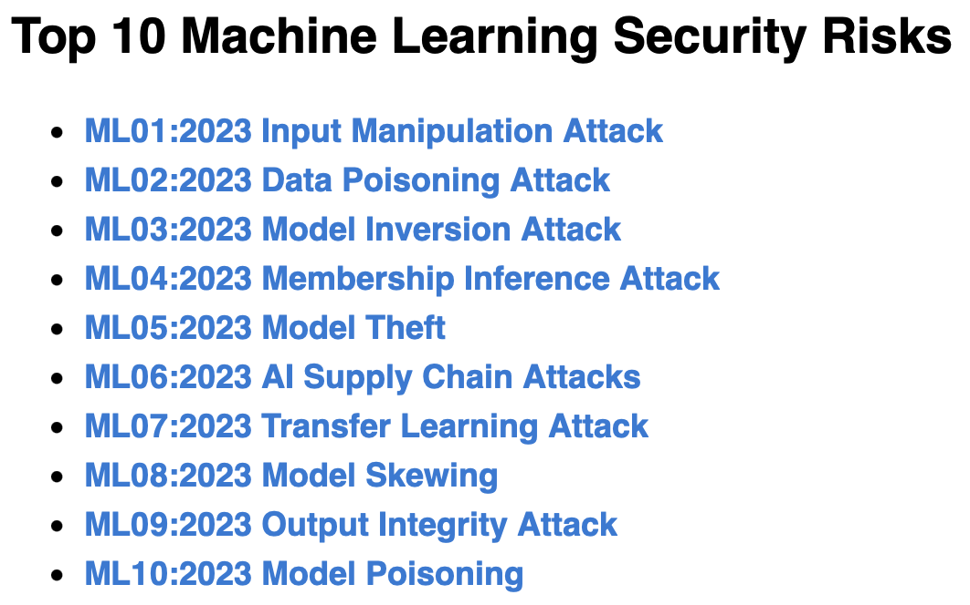
ML OWASP Top 10
Source: https://owasp.org/www-project-machine-learning-security-top-10/

Slide 6
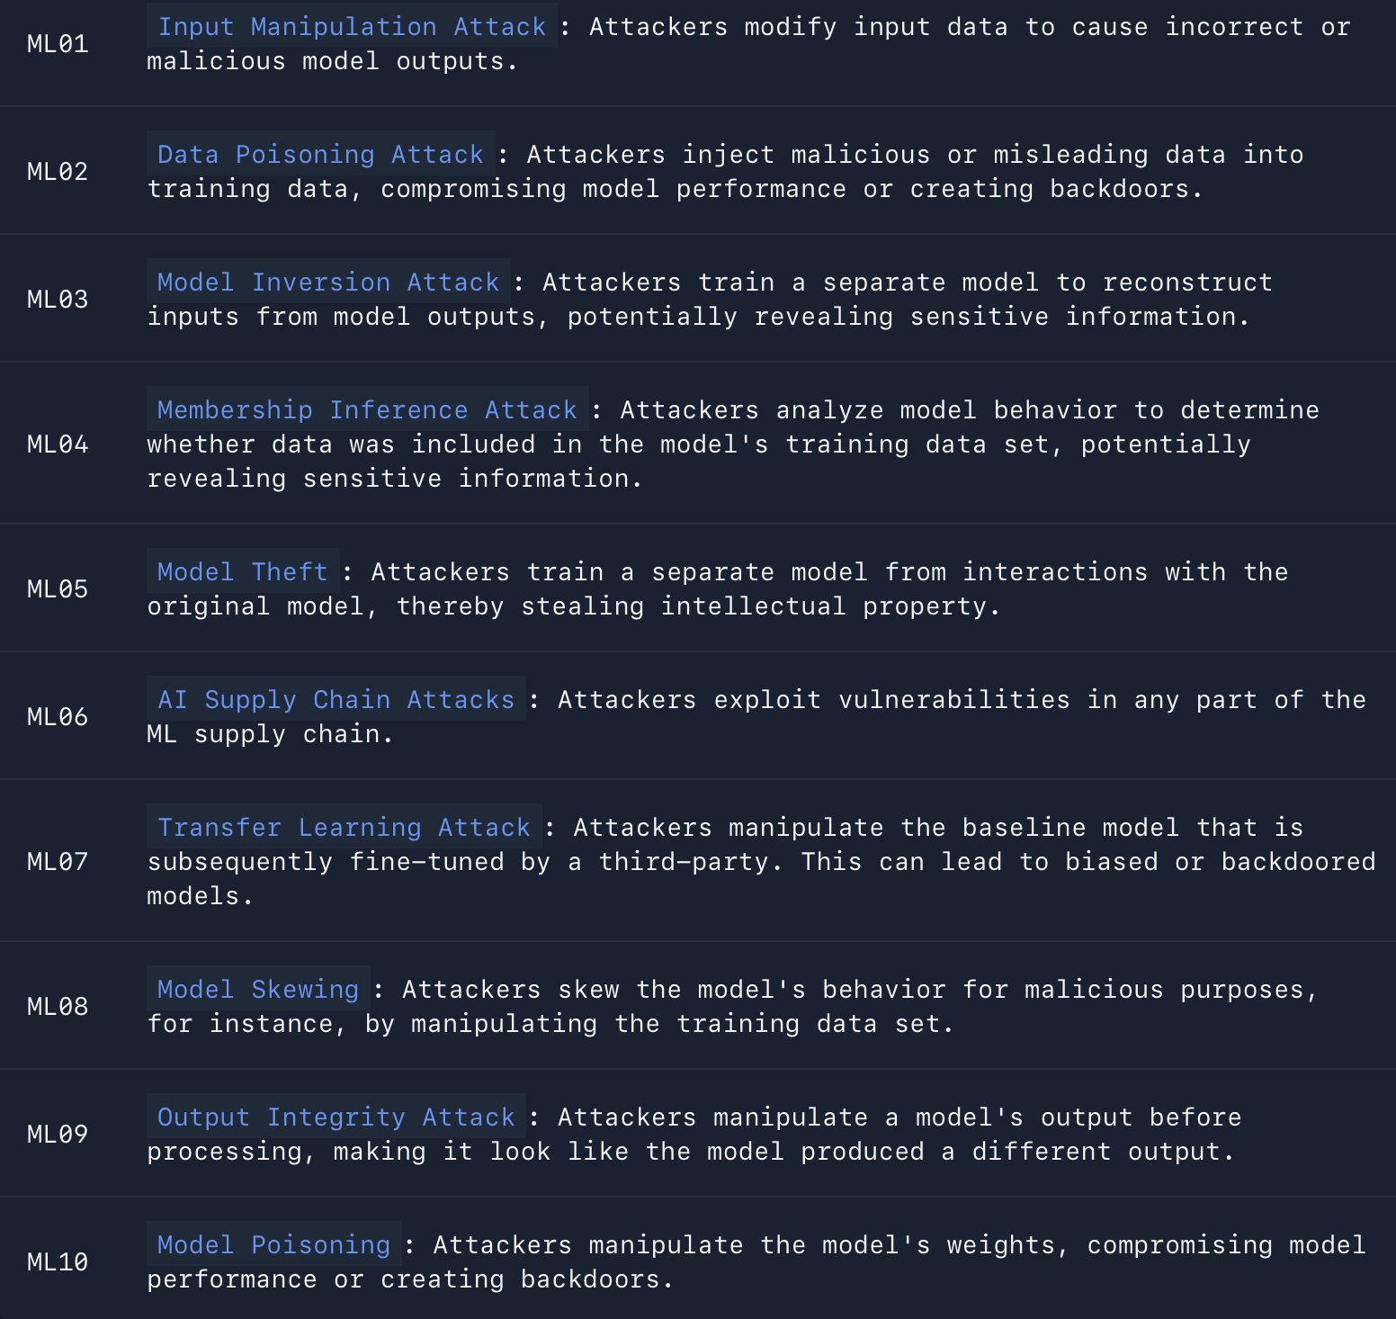
What are the top 10 ML OWASP
https://arxiv.org/pdf/1707.08945, https://arxiv.org/pdf/2307.08278, https://arxiv.org/pdf/2408.13221 https://arxiv.org/pdf/2311.13647 https://arxiv.org/pdf/2402.07841

Slide 7
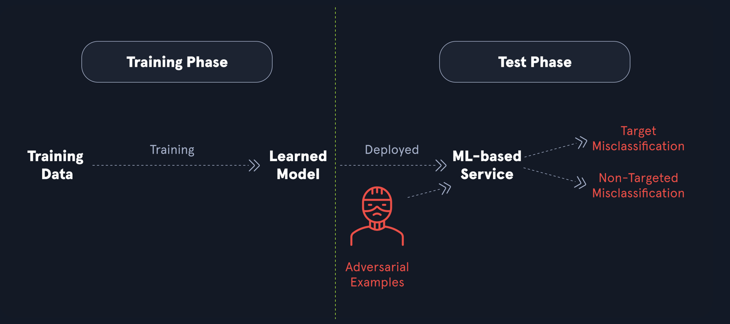
Input Manipulation Attack

Slide 8
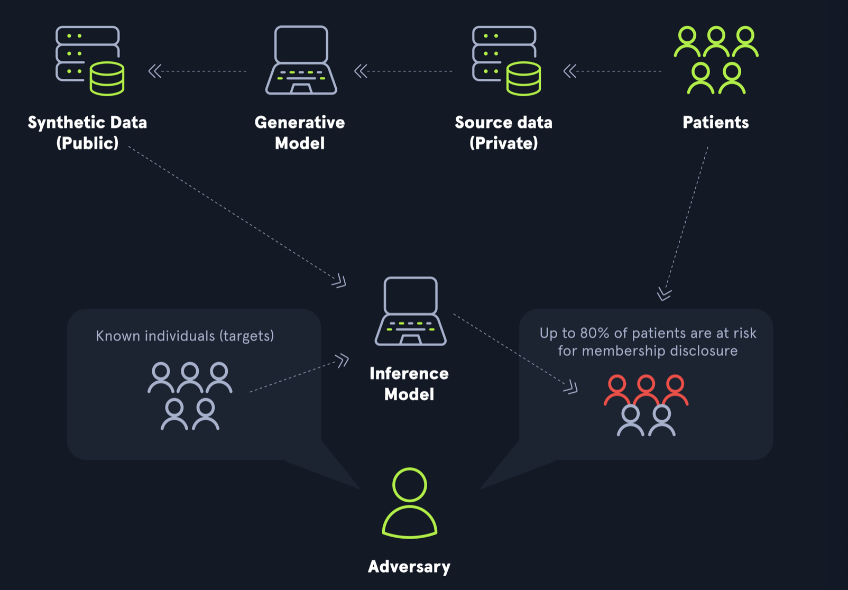
Membership Inference Attack

Slide 9
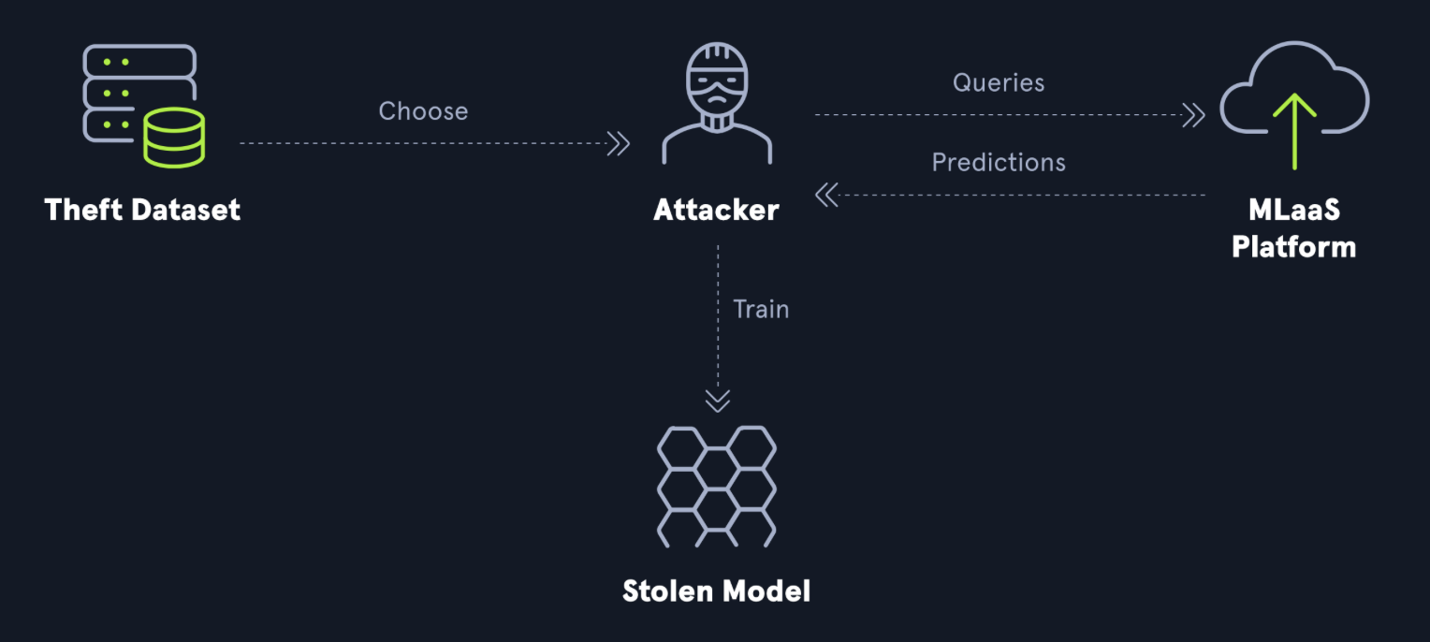
Model Theft

